Slide 1
Maximum Likelihood and Bootstrap Confidence Intervals

Slide 2
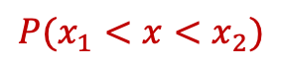
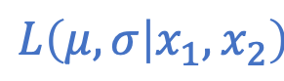
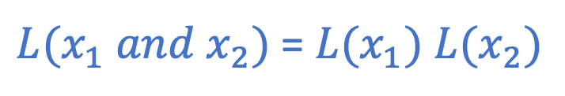
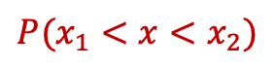
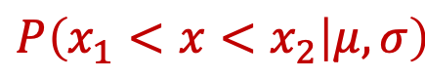
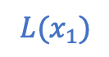

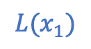
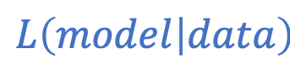
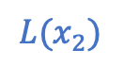
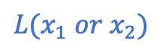
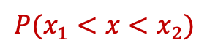
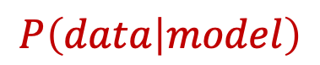
Likelihood
$${P(x}_{1}<x<x_{2})$$
$${P(x}_{1}<x<x_{2})$$
$${P(x}_{1}<x<x_{2})$$
$${L(x}_{1})$$
$${L(x}_{1})$$
$${L(x}_{1} or x_{2})$$
$${L(x}_{2})$$
$${L(x}_{2})$$
$$L\left(μ, σ | x_{1}, x_{2}\right)$$
$$P\left(x_{1}<x<x_{2} | μ, σ\right)$$
$$L\left(model | data\right)$$
$$P\left(data | model\right)$$
${L(x}_{1} and x_{2})$ = ${L(x}_{1})$ ${L(x}_{2})$
${{LL(x}_{1} and x_{2})\text{ =} ln⁡(L(x}_{1} and x_{2})$) = ${ln⁡(L(x}_{1}))$+ $ln({L(x}_{2}))$ = ${LL(x}_{1})$ +${LL(x}_{2})$

Slide 3
Maximum Likelihood Estimation (MLE)
Goal: find distribution parameters that maximize the likelihood of all the data.
→ Fitting a histogram of your data is NOT as good as fitting the data themselves !!!
PDF
counts

Slide 4
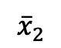
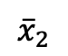

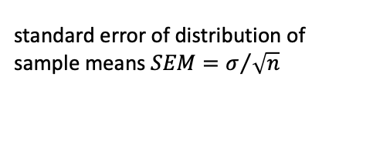
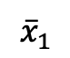
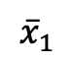
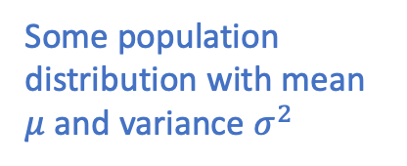
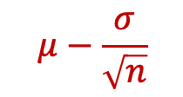
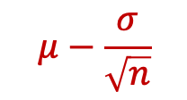




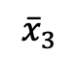
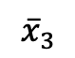


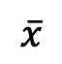
Central Limit Theorem
$$n$$
$${\overline{x}}_{1}$$
$$n$$
$$n$$
$$n$$
$${\overline{x}}_{2}$$
$$N$$
$$n$$
$$n$$
$${\overline{x}}_{3}$$
.
.
.
standard error of distribution of sample means $SEM=σ/{\sqrt{n}}$
Some population distribution with mean $μ$ and variance $σ^{2}$
$${\overline{x}}_{1}$$
$${\overline{x}}_{2}$$
$${\overline{x}}_{3}$$
$$\overline{x}$$
$$μ−\frac{σ}{\sqrt{n}}$$
$$μ$$
$$μ−\frac{σ}{\sqrt{n}}$$

Slide 5


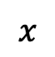
Confidence Interval
scipy.stats.norm.ppf(0.027)
scipy.stats.norm.ppf(0.973)
$$x$$
$$P\left(x<μ−2σ\right)=0.027=2.7\%$$
$$P\left(x>μ+2σ\right)=0.027=2.7\%$$

Slide 6
Bootstrap
$$n$$
$${\overline{x}}_{1}$$
$$n$$
$${\overline{x}}_{1}$$
$$n$$
$${\overline{x}}_{2}$$
$$n$$
$$n$$
Generate plausible data sets that could have happened based on the original data set.
$$n$$
$${\overline{x}}_{3}$$
$$N$$
.
.
.
$$n$$
Use our measured data set to estimate what a whole series of sample data sets might look like.
Each “bootstrapped” data set is the same size as out original data set, and we create it by selecting random values from our original data set with replacement.
Then use those ”bootstrapped” data sets to estimate the distribution of some statistical parameter.
This distribution gives us an estimate of how confident we are in the maximum likelihood estimate for that parameter.
Some population distribution with mean $μ$ and variance $σ^{2}$

Slide 7
Sample with replacement
measured data: [ 1, 2, 3, 4, 5 ]
bootstrap sample #1: [ 2, 2, 5, 4, 5 ]
bootstrap sample #2: [ 3, 1, 2, 3, 2 ]
bootstrap sample #3: [ 5, 4, 5, 2, 1 ]
…

